Slide 1
Advanced Charts
Radial Bar Chart

Slide 2
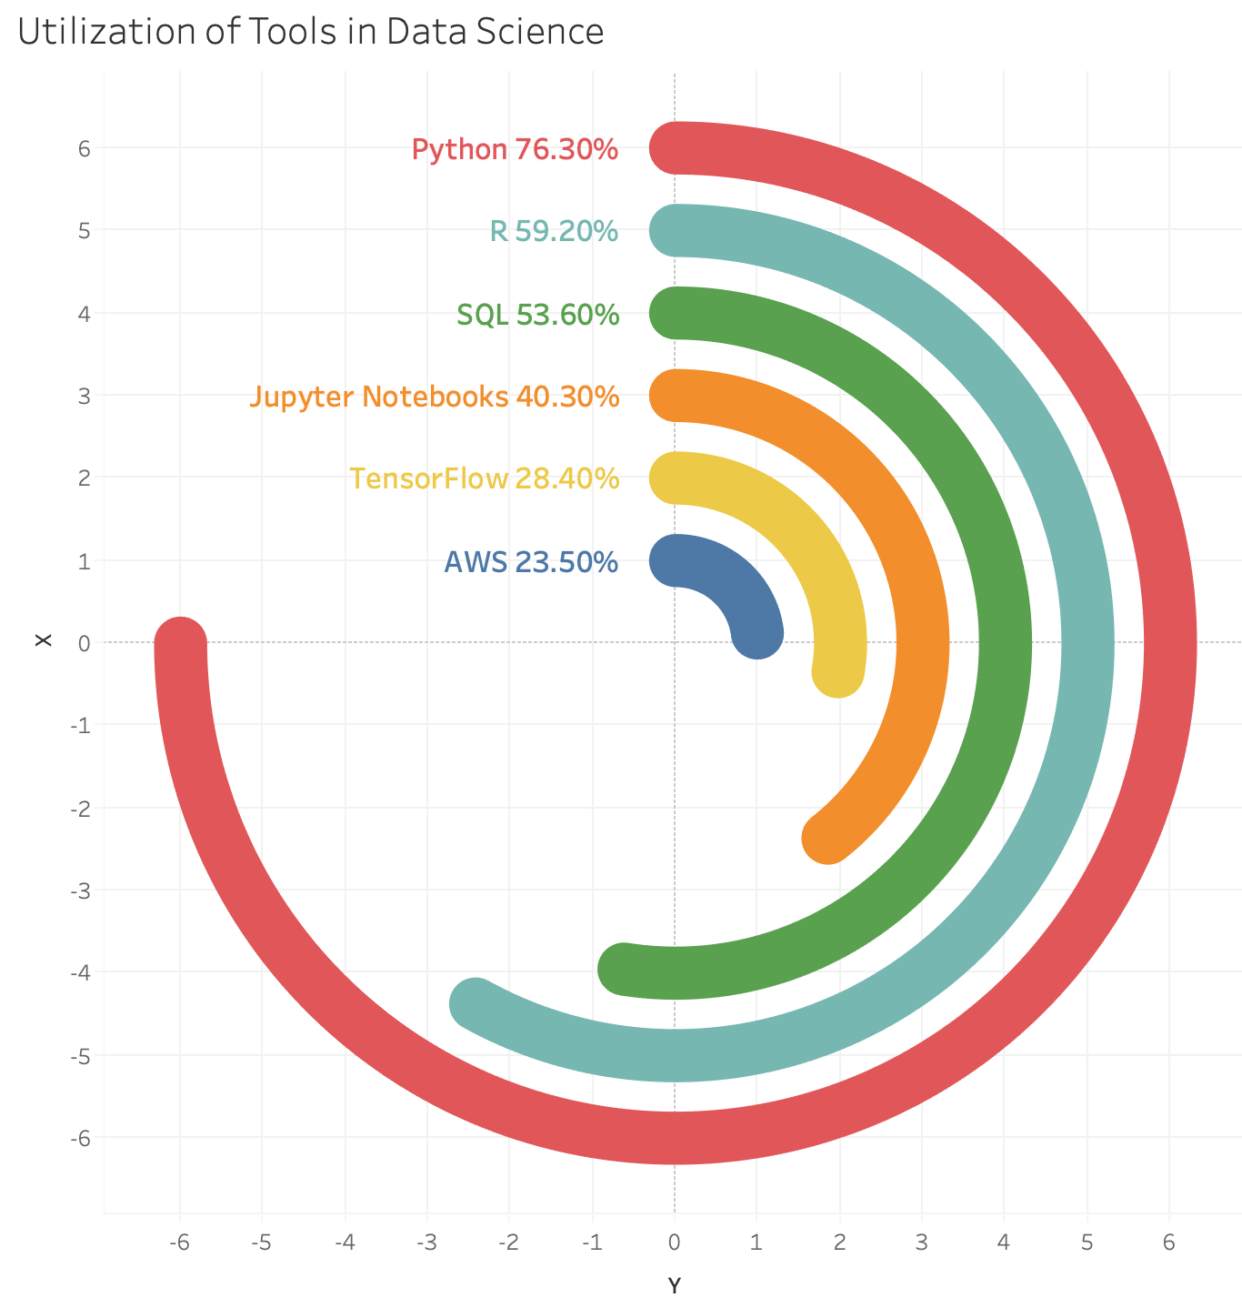
Radial Bar Chart
The Radial Bar Chart is a circular bar chart.
The highest value is plotted, and all other values are plotted compared to the highest value.
The highest value is plotted as 270 degrees around the circle.

Slide 3
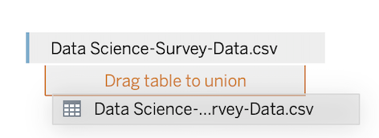
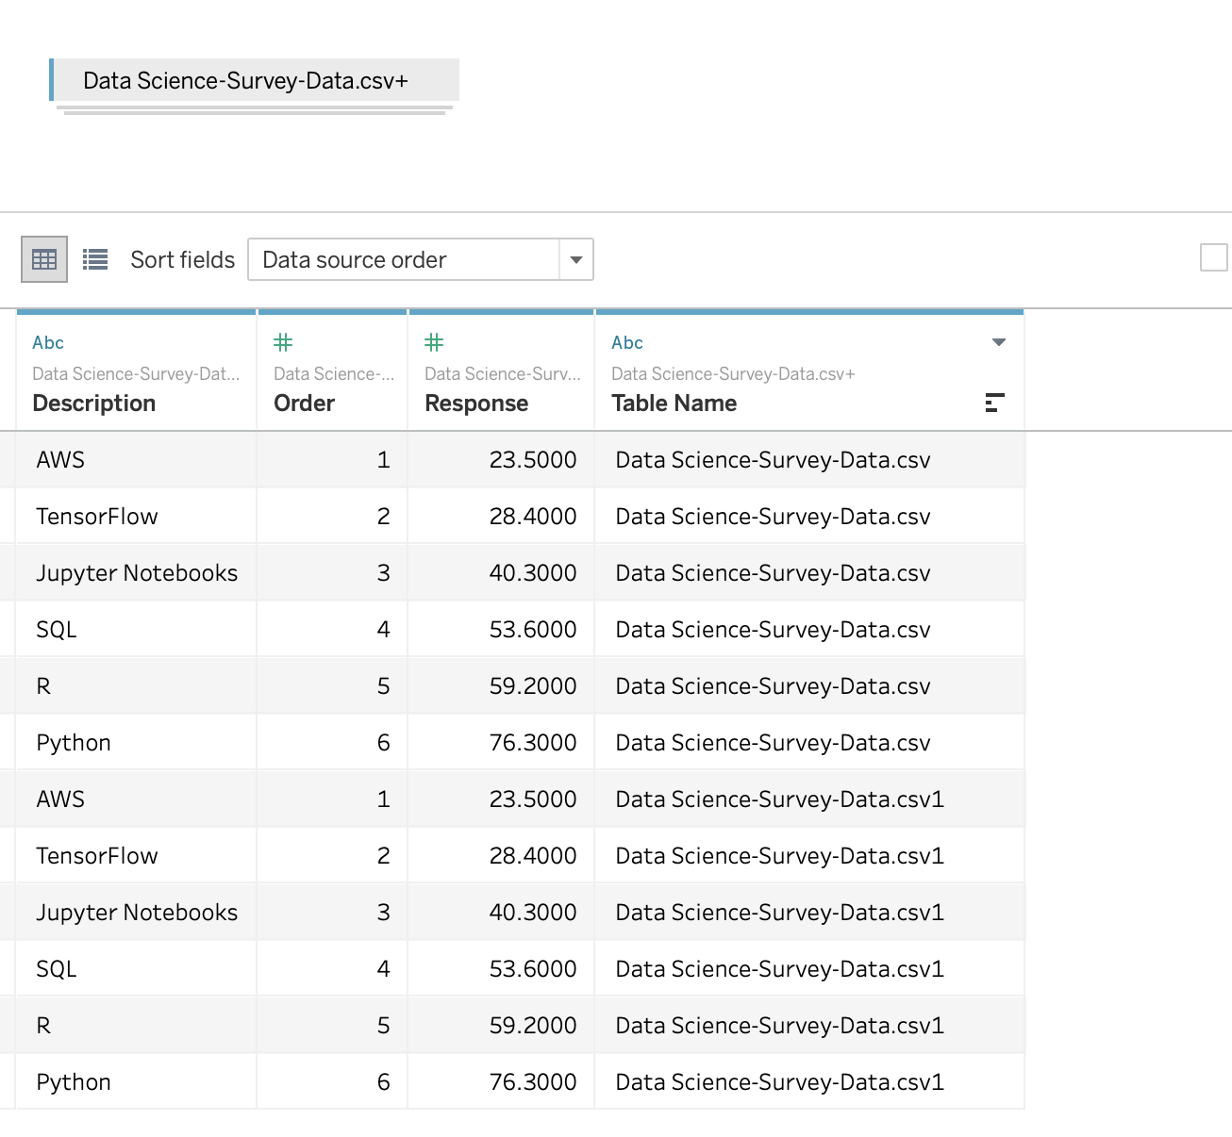
Building the Radial Bar Chart
First, create a new Tableau file and open Data Science-Survey-Data.csv
Add Data Science-Survey-Data to the data source, then UNION it to itself.
When finished it will look like this ->

Slide 4
Building the Radial Bar Chart
First, create a new Tableau file and open Data Science-Survey-Data.csv
Add Data Science-Survey-Data to the data source, then UNION it to itself.
When finished it will look like this ->

Slide 5
Building the Radial Bar Chart
Create a new calculated field called “Path”
Formula:
  ﻿IF [Table Name] = ﻿'Data Science-Survey-Data.csv'
  THEN 0
  ELSE [Response]*270/{MAX([Response])}
  END
Change “Path” to a Dimension
This creates a field that will be used to direct the path of the radial lines. The number 270 is used to denote 270 degrees. This step creates a field called “Path” with a number that is a ratio of each value to the highest value between 0 and 270.

Slide 6
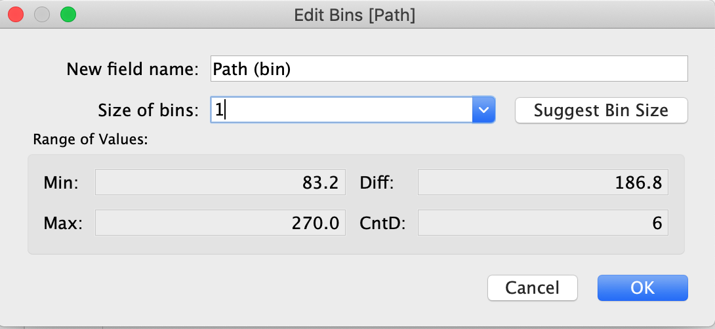
Building the Radial Bar Chart
Create a “Path (bin)” field with bin size of 1.
  Right click on “Path” and choose Create-> Bin

Slide 7
Building the Radial Bar Chart
Create several fields for calculation:
  “Pi” – 3.14159
  “Rank” - ﻿Rank(-SUM([Response])) // Creates a reverse rank
  “Rank Max” - ﻿WINDOW_MAX( [Rank] )
  “Response Percent” - ﻿[Response]/100
  “X” - ﻿COS((Index()-1)*[Pi]/180)*[Rank Max]
  “Y” - ﻿SIN((INDEX()-1)*[Pi]/180)*[Rank Max]

Slide 8
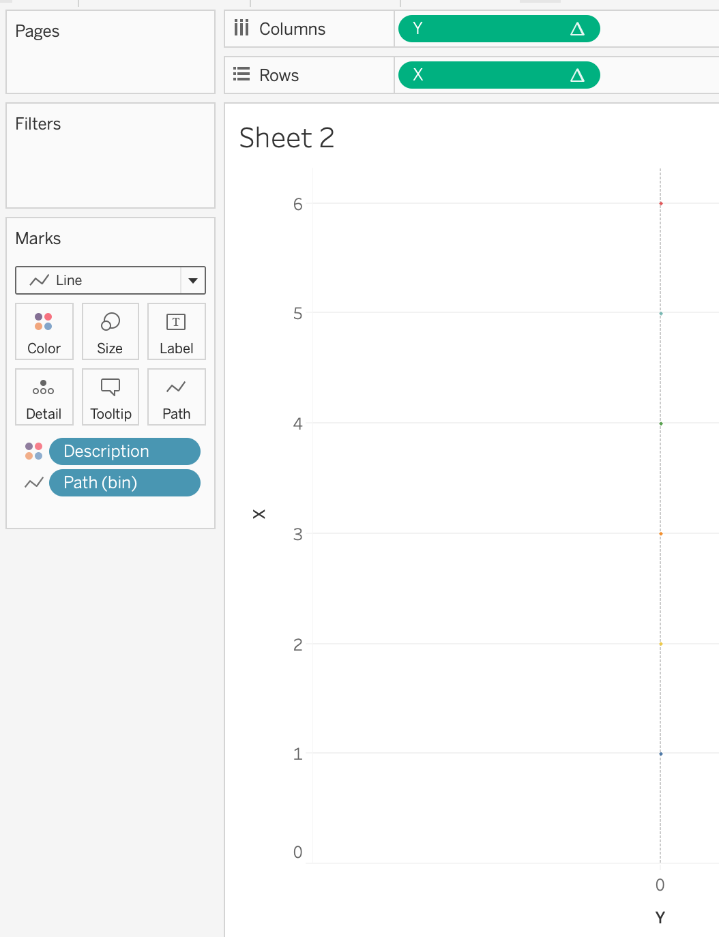
Building the Radial Bar Chart
Change mark type to “Line”
Move Path (bin) to Path on the Marks Card
Add Y to Columns
Add X to Rows

Slide 9
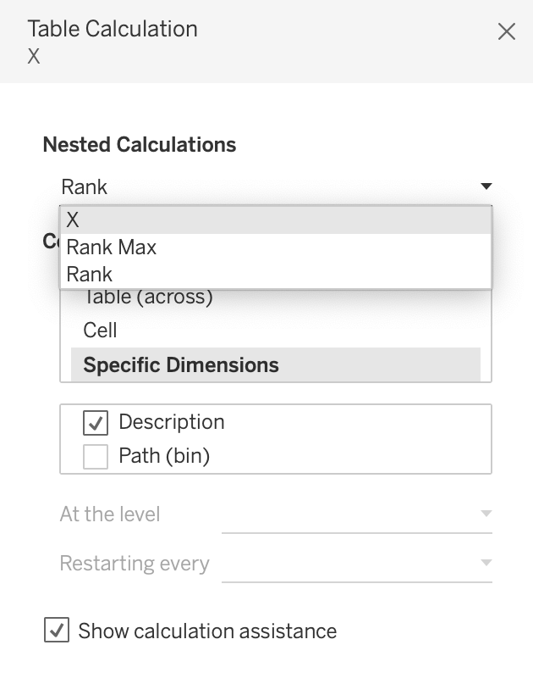
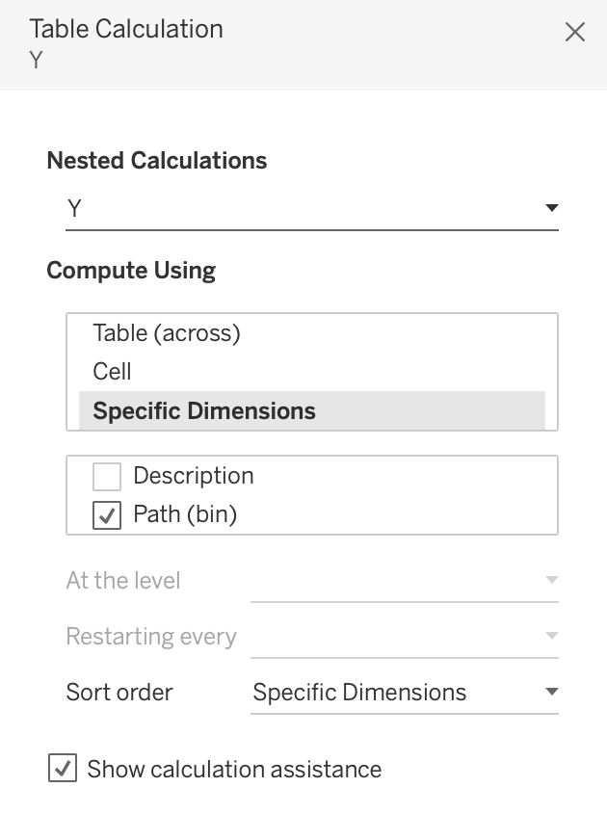
Building the Radial Bar Chart
Edit table calculations – make sure that:
X & Y are computed along Path(bin)
Rank Max is computed along Path(bin)
Rank is computed along Description

Slide 10
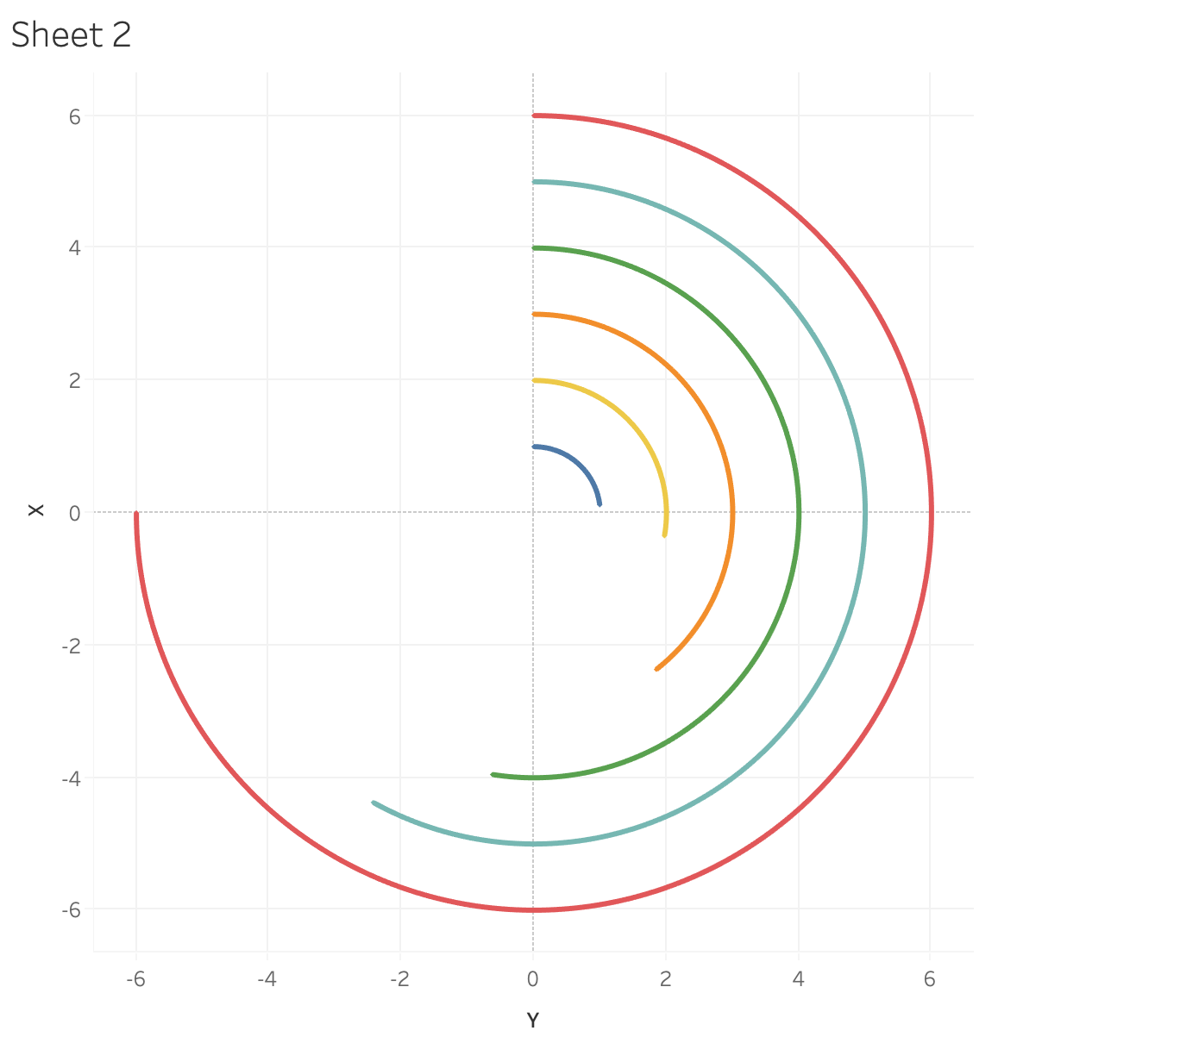
Building the Radial Bar Chart
The chart should look like this:

Slide 11
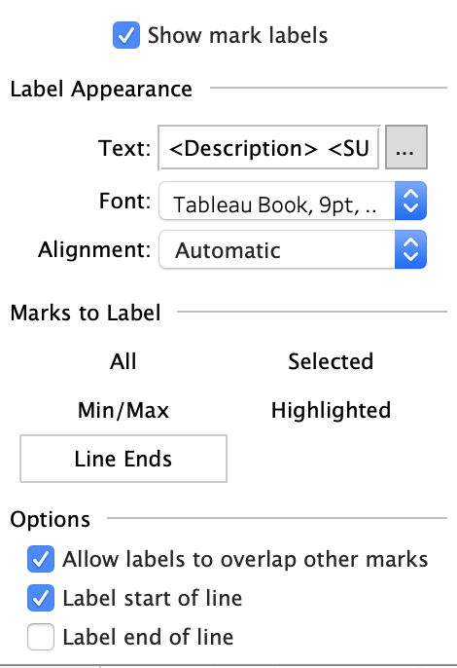
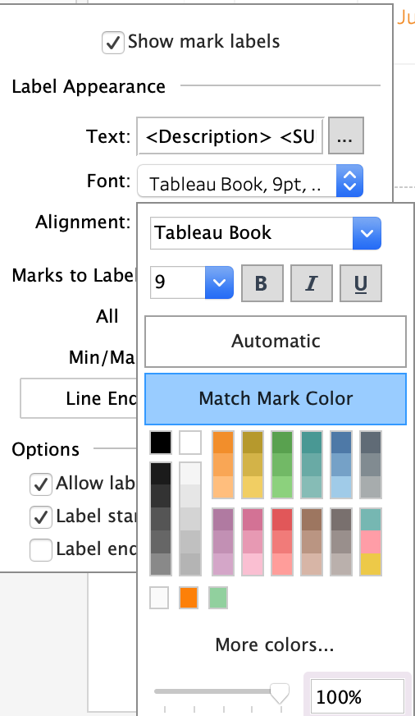
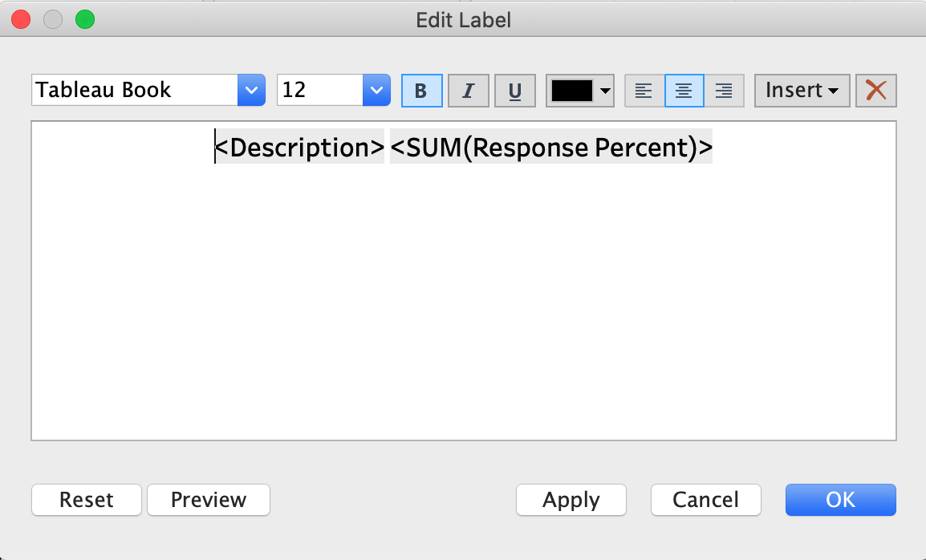
Building the Radial Bar Chart
Slide the Size Mark slider almost all the way to the right.
Add Description and Response Percent to the Label Mark.
Show label at start of line, match mark color, and reformat

Slide 12
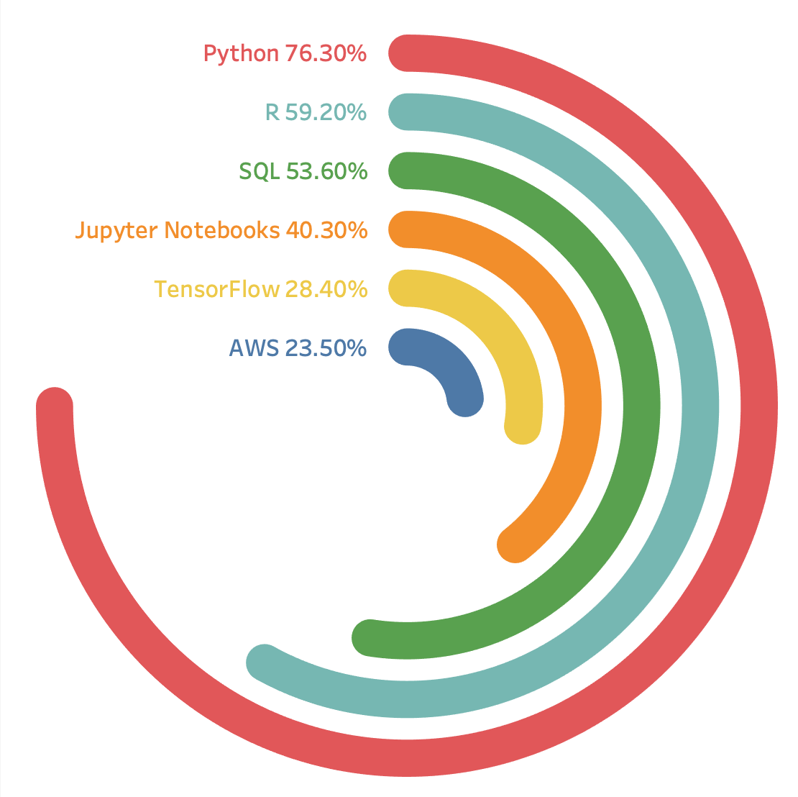
Building the Radial Bar Chart
Remove X & Y Axis headers
Go to Format Pane, and for columns and rows remove:
  Gridlines
  Zero lines

